Slide 1
Invertebrates Lab

Slide 2
Instructions
Refer to the animal diagrams below when answering the questions on the lab report. Some of the things should be familiar because you already saw them in lecture (symmetry, coelom). You see them twice because they are important!
Read the background section of the worksheet and watch the the videos associated with each section. Take a look at the dissection diagrams below before you complete the lab sections on those organisms.
Complete the summary chart at the end of the lab worksheet. Make sure you follow the instructions on the worksheet.

Slide 3
Video 1 – Animals—what do they all have in common?
https://www.youtube.com/watch?v=wd-QnKlfZHI

Slide 4
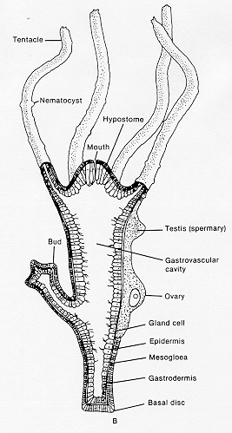
Video 2 - Hydra
https://www.youtube.com/watch?v=jnD_YitEk5M

Slide 5
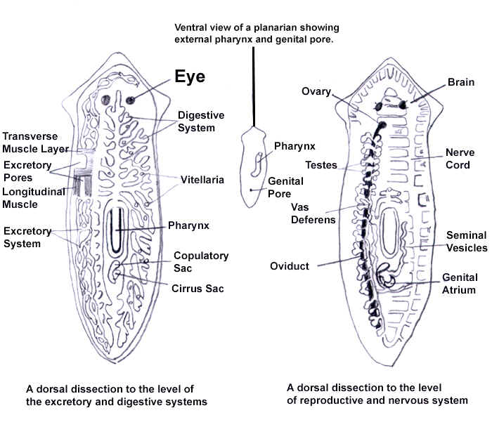
Video 3 – Planaria
https://www.youtube.com/watch?v=hTC1eNTBXvE
https://www.youtube.com/watch?v=Xod7LLHBHb4

Slide 6
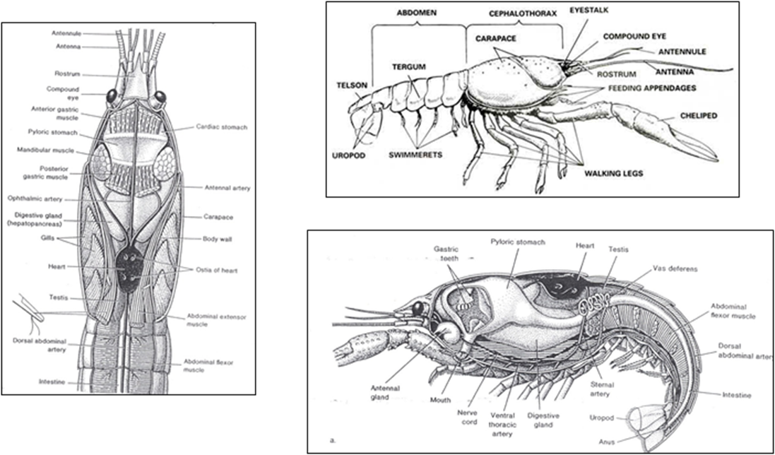
Video 4 – Crayfish
https://www.youtube.com/watch?v=W7F0jZgdc8A

Slide 7
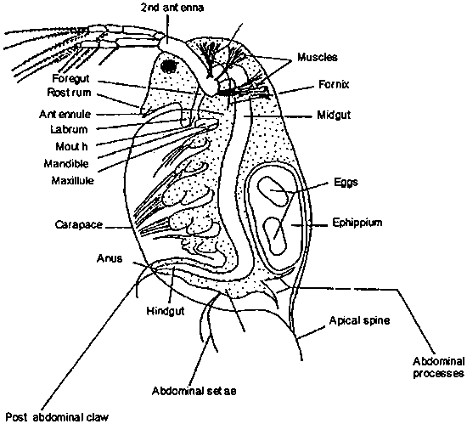
Video 5 - Daphnia
https://www.youtube.com/watch?v=A4TRXFGV8Bg

